Slide 1

The Importance of Knowing Algorithms
19CSE201 Advanced Programming
Lecture 11

Slide 2
Introduction
The first step towards an understanding of why the study and knowledge of algorithms are so important is to define exactly what we mean by an algorithm.
According to the popular algorithms textbook Introduction to Algorithms (Second Edition by Thomas H. Cormen), “an algorithm is any well-defined computational procedure that takes some value, or set of values, as input and produces some value, or set of values as output.”

Slide 3
In other words, algorithms are like road maps for accomplishing a given, well-defined task.
Even a simple function for adding two numbers is an algorithm in a sense, a simple one.
Some algorithms, like those that compute the Fibonacci sequences, are intuitive and may be innately embedded into our logical thinking and problem solving skills.
However, for most of us, complex algorithms are best studied so we can use them as building blocks for more efficient logical problem solving in the future.

Slide 4
Analyze your algorithm
Proof of algorithm correctness
Time/Space complexity analysis for non recursive algorithms
For recursive algorithms, the knowledge of computing recurrence relations and analyze them: iterative method, substitution method, recursion tree method and finally, Master Theorem
Given the maximum input bound (usually given in problem description), can my algorithm, with the complexity that I can compute, pass the time limit given in the programming contest?

Slide 5
Runtime Analysis
One of the most important aspects of an algorithm is how fast it is.
It is often easy to come up with an algorithm to solve a problem, but if the algorithm is too slow, it’s back to design phase.
Since the exact speed of an algorithm depends on where the algorithm is run, as well as the exact details of its implementation, computer scientists typically talk about the runtime relative to the size of the input.
For example, if the input consists of N integers, an algorithm might have a runtime proportional to N , represented as O(N ).

Slide 6

Contd..
This means that if you were to run an implementation of the algorithm on your computer with an input of size N, it would take C*N seconds, where C is some constant that doesn’t change with the size of the input.

Slide 7
Design approaches
The following is a list of several popular design approaches:
Divide and Conquer Approach:
It is a top-down approach. The algorithms which follow the divide & conquer techniques involve three steps:
Divide the original problem into a set of smaller instances of the same problem.
Solve every subproblem individually, recursively.
Combine the solution of the subproblems (top level) into a solution of the whole original problem.

Slide 8
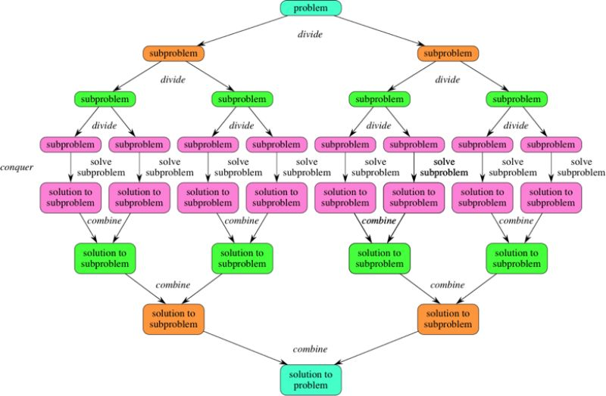
Divide and Conquer Approach:

Slide 9
Greedy Technique
Greedy method is used to solve the optimization problem.
An optimization problem is one in which we are given a set of input values, which are required either to be maximized or minimized (known as objective), i.e. some constraints or conditions.
Greedy Algorithm always makes the choice (greedy criteria) looks best at the moment, to optimize a given objective.
The greedy algorithm doesn't always guarantee the optimal solution however it generally produces a solution that is very close in value to the optimal.

Slide 10
Greedy Algorithm Contd.
Greedy algorithm in animation below aims to locate the path with the largest sum.
With a goal of reaching the largest sum, at each step, the greedy algorithm will choose what appears to be the optimal immediate choice, so it will choose 12 instead of 3 at the second step and will not reach the best solution, which contains 99.

Slide 11
Dynamic Programming
Dynamic Programming is a bottom-up approach we solve all possible small problems and then combine them to obtain solutions for bigger problems.
Dynamic Programming is frequently related to Optimization Problems.
Dynamic Programming is a good methodology for optimization problems that seek the maximal or minimal solution with restrictions as it searches through all possible sub-problems and never recomputes the conclusion to any sub-problem.

Slide 12
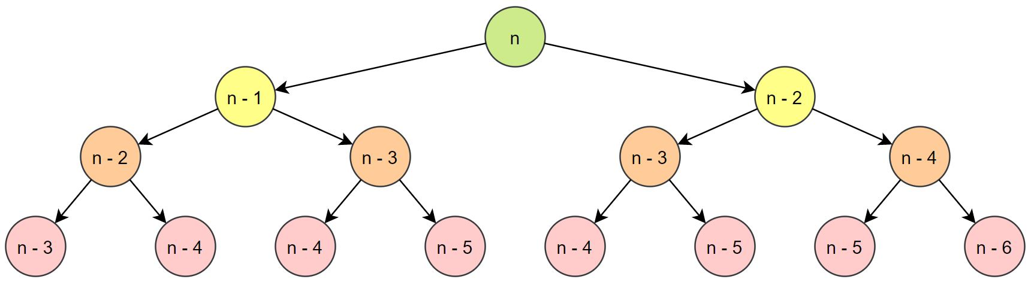

Dynamic Programming Contd.
It’s an algorithmic strategy for breaking down an optimization problem into smaller sub-problems and leveraging the fact that the best solution for the overall problem is defined by the best solution for its sub-problems.
For example, in case of Fibonacci Series in which each number is the sum of the two preceding numbers. Suppose the first two numbers of the series are 0, 1. If it is asked to find the nth number of the series, we can do that as follows:

Slide 13
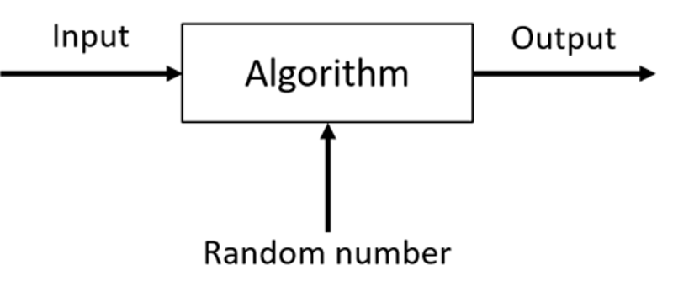
Randomized Algorithms
Randomized Algorithm refers to an algorithm that uses random numbers to determine what to do next at any point in its logic.
In a standard algorithm, it is usually used to reduce either the running time, or time complexity, or the memory used, or space complexity.
The algorithm works by creating a random number, r, from a set of numbers and making decisions based on its value.
This algorithm could assist in making a decision in a situation of doubt by flipping a coin or drawing a card from a deck.
Example 1:
In Quick Sort, using a random number to choose a pivot.

Slide 14
Backtracking Algorithm
Backtracking Algorithm tries each possibility until they find the right one.
It is a depth-first search of the set of possible solution. During the search, if an alternative doesn't work, then backtrack to the choice point, the place which presented different alternatives, and tries the next alternative.
For example, if we want to find all the possible ways of arranging 2 boys and 1 girl on 3 benches with a constraint that girl should not be on the middle bench.
So, there will be 3! = 6 possibilities to solve this problem. We will try all possible ways recursively to get the required solution. Those possibilities are as follows:

Slide 15
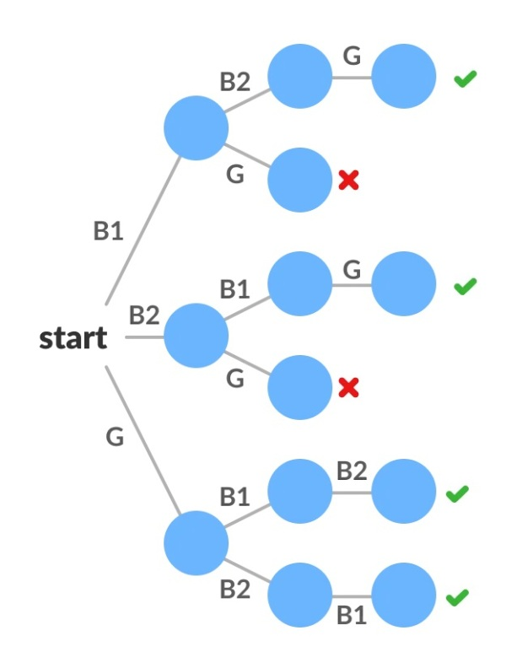
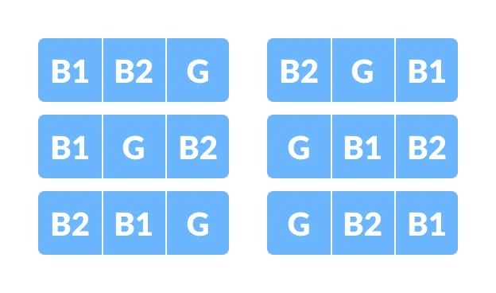
Backtracking Algorithm Contd.
Backtracking Example Possibilities
Solutions of Backtracking

Slide 16
The Importance of Knowing Algorithms
As a computer scientist, it is important to understand all of these types of algorithms so that one can use them properly.
If you are working on an important piece of software, you will likely need to be able to estimate how fast it is going to run.
Such an estimate will be less accurate without an understanding of runtime analysis.
Furthermore, you need to understand the details of the algorithms involved so that you’ll be able to predict if there are special cases in which the software won’t work quickly, or if it will produce unacceptable results.

Slide 17
Contd..
Of course, there are often times when you’ll run across a problem that has not been previously studied.
In these cases, you have to come up with a new algorithm, or apply an old algorithm in a new way.
The more you know about algorithms in this case, the better your chances of finding a good way to solve the problem.
In many cases, a new problem can be reduced to an old problem without too much effort, but you will need to have a fundamental understanding of the old problem in order to do this.

Slide 18
Summary
The different algorithms that people study are as varied as the problems that they solve.
However, chances are good that the problem you are trying to solve is similar to another problem in some respects.
By developing a good understanding of a large range of algorithms, you will be able to choose the right one for a problem and apply it properly.

Slide 19
Some rules of thumb
Biggest built-in data structure "long long" is 2^63-1: 9*10^18 (up to 18 digits)
If you have k nested loops running about n iterations each, the program has O(n^{k}) complexity
The best times for sorting n elements are O(nlog n)
In contests, most of the time O(n log n) algorithms will be sufficient

